Slide 1
PREDICTING STOCK MARKET MOVEMENTS USING CNN
Presented by: Rishika B
III year,KVCET
NM ID-au421221243031
Email ID-rrishika578@gmail.com

Slide 2
PROPOSED SYSTEM
A Convolutional Neural Network (CNN) based system for predicting stock market movements can be developed by first preprocessing historical stock price data into image-like representations, such as time series plots. Then, a CNN architecture is constructed with convolutional layers to extract features from the input data, followed by pooling layers for dimensionality reduction and fully connected layers for classification. The model is trained on labeled historical data to learn patterns and relationships between input features and corresponding stock movements. Finally, the trained CNN can be used to predict future stock market movements by inputting new data and analyzing the output probabilities. Regularization techniques such as dropout and batch normalization can be employed to prevent overfitting and improve generalization. Additionally, hyperparameter tuning and cross-validation techniques can be utilized to enhance model performance and robustness.

Slide 3
PROBLEM STATEMENT
The problem entails developing a Convolutional Neural Network (CNN) model to predict stock market movements. Leveraging historical stock data, the CNN will learn patterns and relationships within the data to forecast future price movements. The model will be tasked with analyzing various features such as historical price trends, trading volumes, and possibly external factors like news sentiment. By processing the data through convolutional layers, the CNN will extract relevant features and patterns crucial for accurate predictions. The goal is to create a robust predictive model capable of forecasting market movements with high accuracy, aiding investors and traders in making informed decisions. The success of this endeavor would significantly benefit financial markets by providing valuable insights into potential market trends and facilitating better risk management strategies.

Slide 4
PROPOSED SOLUTION
Data Preparation: Gather historical stock price data along with relevant features such as volume, technical indicators, and news sentiment. Organize the data into a format suitable for training the CNN.
Feature Extraction: Extract features from the raw data that are relevant for predicting stock movements. This could include price changes, moving averages, relative strength index (RSI), moving average convergence divergence (MACD), etc.
CNN Architecture Design: Design a CNN architecture suitable for processing the input data. This may involve a combination of convolutional layers, pooling layers, and fully connected layers.

Slide 5
Training: Split the data into training and testing sets. Train the CNN on the training set using techniques like backpropagation and gradient descent. Use appropriate loss functions such as mean squared error or binary cross-entropy.
Evaluation: Evaluate the performance of the trained CNN on the testing set using metrics like accuracy, precision, recall, and F1-score. Adjust the model hyperparameters as necessary to improve performance.
Prediction: Once the model is trained and evaluated, use it to make predictions on unseen data. Monitor the predictions against actual market movements to assess the model's effectiveness.
Fine-Tuning or Optimization: Continuously refine the CNN architecture, feature selection, and training process to improve prediction accuracy. This may involve experimenting with different network architectures, optimization algorithms, and data preprocessing techniques.

Slide 6
SYSTEM APPROACH
System Requirements:
Hardware :
A CPU with multiple cores or a GPU with parallel processing capabilities is recommended to handle the intensive computations involved in training and inference of CNN models. At least 8GB of RAM is advisable to accommodate the data processing and model training tasks efficiently. Additionally, a solid-state drive (SSD) for storage is preferred to ensure fast data access speeds.
Software:
To predict stock market movements using a Convolutional Neural Network (CNN), you'll need a robust software environment. Firstly, a programming language such as Python for its extensive libraries and frameworks. Secondly, deep learning frameworks like TensorFlow or PyTorch to build and train the CNN model efficiently. Thirdly, data processing tools like Pandas and NumPy to handle and preprocess the stock market data. Fourthly, visualization libraries such as Matplotlib or Seaborn to analyze and visualize the model's performance and predictions. Lastly, access to historical and real-time stock market data sources for training and testing the CNN model effectively.

Slide 7
ALGORITHM AND DEPLOYMENT
Data exploration:
Obtain historical stock market data including price, volume, and other relevant indicators. Visualize the data to understand trends, patterns, and correlations. Preprocess the data, which may include handling missing values, normalization, and feature engineering.
Problem formulation:
Define the problem you want to solve, such as predicting stock price movements (e.g., up or down) based on historical data. Determine the time horizon for prediction (e.g., next day, next week). Decide on the input features (e.g., past prices, volumes, technical indicators). Choose an appropriate evaluation metric (e.g., accuracy, precision, recall, F1-score).

Slide 8
Algorithm selection:
Consider using a Convolutional Neural Network (CNN) for its ability to capture spatial relationships in data. CNNs have been successful in image recognition tasks, and can also be applied to sequential data like time-series. For stock market prediction, a 1D CNN can be used to process sequential data effectively. Alternatively, you may also explore other algorithms such as Long Short-Term Memory (LSTM) networks or hybrid models combining CNNs and LSTMs.

Slide 9
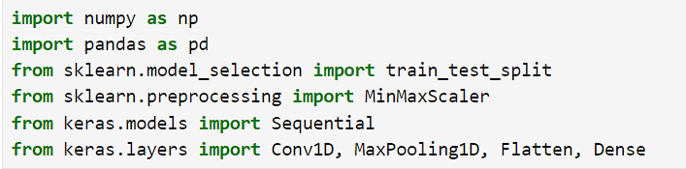
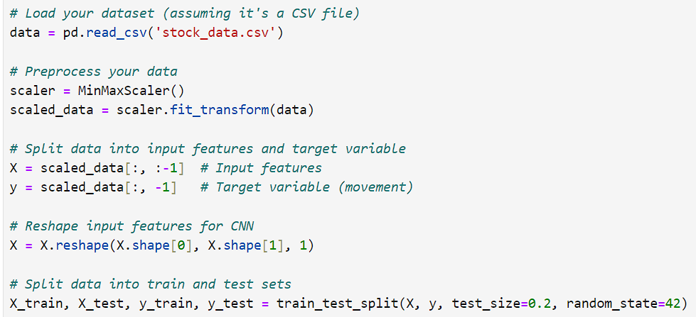
TRAINING AND PROCESS
Importing Libraries:
Data Splitting:

Slide 10
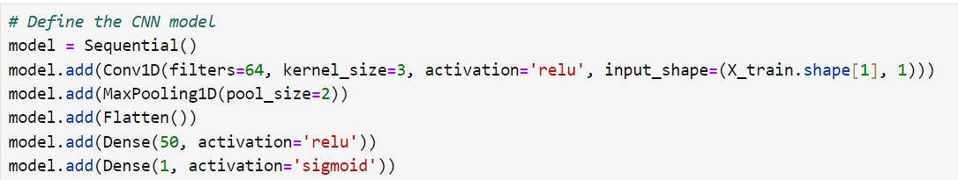
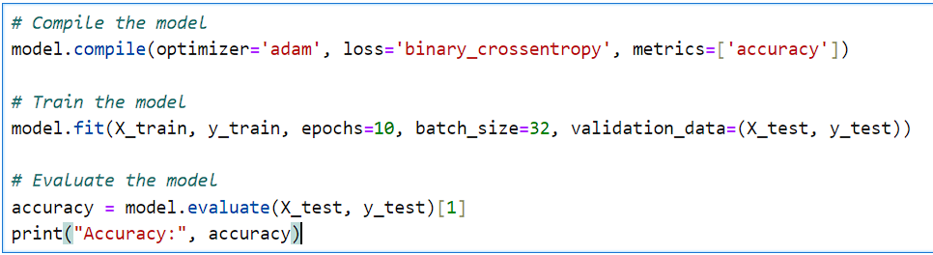
Model Defining and Training:
Model Evaluation:

Slide 11
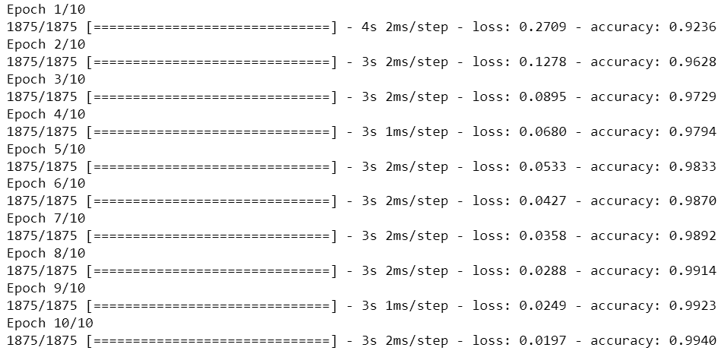
RESULT
Training Result:
Evaluation Result:

Slide 12
CONCLUSION AND FUTURE DIRECTIONS
New AI technologies can enhance predictive capabilities and improve decision-making in stock trading.
Advanced techniques for analyzing big data can offer deeper insights into stock market behaviors.
Continual development of advanced algorithms can lead to more accurate and reliable predictions.

Slide 13
REFERENCES
"Deep Learning for Time Series Forecasting: Predict the Future with MLPs, CNNs and LSTMs" by N.D. Lewis.
"Deep Learning for Finance: Principles and Applications" by Igor Halperin, Erwin Halim, and Daniel Y. Ding.
"Machine Learning for Algorithmic Trading: Predictive models to extract signals from market and alternative data for systematic trading strategies with Python" by Stefan Jansen.
"Time Series Analysis and Forecasting with Convolutional Neural Networks" by Ahmed Fawzy Gad.
"Financial Signal Processing and Machine Learning" by Ali N. Akansu, Sanjeev R. Kulkarni, and Dmitry M. Malioutov.

